Slide 1
Lecture 15
Memory Test
Memory market and memory complexity
Notation
Faults and failures
MATS+ March Test
Memory fault models
March test algorithms
Inductive fault analysis
Summary

Slide 2
Density and Defect Trends
1970 -- DRAM Invention (Intel) 1024 bits
1993 -- 1st 256 MBit DRAM papers
1997 -- 1st 256 MBit DRAM samples
  1 /bit --> 120 X 10⁻⁶ /bit
Kilburn -- Ferranti Atlas computer (Manchester U.) -- Invented Virtual Memory
  1997 -- Cache DRAM -- SRAM cache + DRAM now on 1 chip

Slide 3
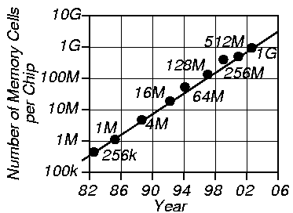
Memory Cells Per Chip

Slide 4
Test Time in Seconds
(Memory Size n Bits)
Size Number of Test Algorithm Operations
n
1 Mb
4 Mb
16 Mb
64 Mb
256 Mb
1 Gb
2 Gb
n
0.06
0.25
1.01
4.03
16.11
64.43
128.9
n X log₂n
1.26
5.54
24.16
104.7
451.0
1932.8
3994.4
n^{3/2}
64.5
515.4
1.2 hr
9.2 hr
73.3 hr
586.4 hr
1658.6 hr
n²
18.3 hr
293.2 hr
4691.3 hr
75060.0 hr
1200959.9 hr
19215358.4 hr
76861433.7 hr

Slide 5
Notation
0 -- A cell is in logical state 0
1 -- A cell is in logical state 1
X -- A cell is in logical state X
A -- A memory address
ABF -- AND Bridging Fault
AF -- Address Decoder Fault
B -- Memory # bits in a word
BF -- Bridging Fault
C -- A Memory Cell
CF -- Coupling Fault

Slide 6
Notation (Continued)
CFdyn -- Dynamic Coupling Fault
CFid -- Idempotent Coupling Fault
CFin -- Inversion Coupling Fault
coupling cell – cell whose change causes another cell to change
coupled cell – cell forced to change by a coupling cell
DRF -- RAM Data Retention Fault
k -- Size of a neighborhood
M -- memory cells, words, or address set
n -- # of Memory bits
N -- Number of address bits: n = 2^{N}
NPSF -- Neighborhood Pattern Sensitive Fault

Slide 7
Notation (Continued)
OBF -- OR Bridging Fault
SAF -- Stuck-at Fault
SCF -- State Coupling Fault
SOAF -- Stuck-Open Address Decoder Fault
TF -- Transition Fault

Slide 8
Faults
System -- Mixed electronic, electromechanical, chemical, and photonic system (MEMS technology)
Failure -- Incorrect or interrupted system behavior
Error -- Manifestation of fault in system
Fault -- Physical difference between good & bad system behavior

Slide 9
Fault Types
Fault types:
  Permanent -- System is broken and stays broken the same way indefinitely
  Transient -- Fault temporarily affects the system behavior, and then the system reverts to the good machine -- time dependency, caused by environmental condition
  Intermittent -- Sometimes causes a failure, sometimes does not

Slide 10
Failure Mechanisms
Permanent faults:
  Missing/Added Electrical Connection
  Broken Component (IC mask defect or silicon-to-metal connection)
  Burnt-out Chip Wire
  Corroded connection between chip & package
  Chip logic error (Pentium division bug)

Slide 11
Failure Mechanisms (Continued)
Transient Faults:
  Cosmic Ray
  An α particle (ionized Helium atom)
  Air pollution (causes wire short/open)
  Humidity (temporary short)
  Temperature (temporary logic error)
  Pressure (temporary wire open/short)
  Vibration (temporary wire open)
  Power Supply Fluctuation (logic error)
  Electromagnetic Interference (coupling)
  Static Electrical Discharge (change state)
  Ground Loop (misinterpreted logic value)

Slide 12
Failure Mechanisms (Continued)
Intermittent Faults:
  Loose Connections
  Aging Components (changed logic delays)
  Hazards and Races in critical timing paths (bad design)
  Resistor, Capacitor, Inductor variances (timing faults)
  Physical Irregularities (narrow wire -- high resistance)
  Electrical Noise (memory state changes)

Slide 13
Physical Failure Mechanisms
Corrosion
Electromigration
Bonding Deterioration -- Au package wires interdiffuse with Al chip pads
Ionic Contamination -- Na⁺ diffuses through package and into FET gate oxide
Alloying -- Al migrates from metal layers into Si substrate
Radiation and Cosmic Rays -- 8 MeV, collides with Si lattice, generates n - p pairs, causes soft memory error

Slide 14
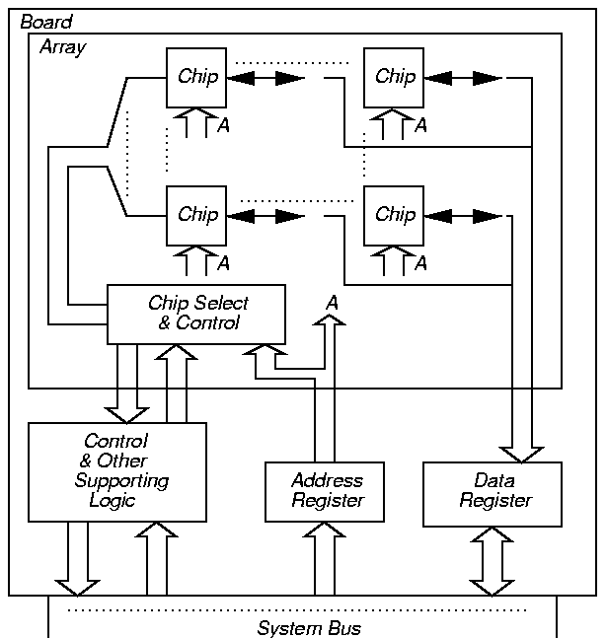
Memory Test Levels
Chip, Array, & Board

Slide 15
March Test Notation
r -- Read a memory location
w -- Write a memory location
r0 -- Read a 0 from a memory location
r1 -- Read a 1 from a memory location
w0 -- Write a 0 to a memory location
w1 -- Write a 1 to a memory location
-- Write a 1 to a cell containing 0
-- Write a 0 to a cell containing 1

Slide 16
March Test Notation (Continued)
-- Complement the cell contents
-- Increasing memory addressing
-- Decreasing memory addressing
-- Either increasing or decreasing

Slide 17
More March Test Notation
A
-- Any write operation
< ... > -- Denotes a particular fault, ...
<I / F > -- I is the fault sensitizing condition, F is the faulty cell value
<I1, ..., In-1 ; In / F> -- Denotes a fault covering n cells
  I1, ..., In-1 are fault sensitization conditions in cells 1 through n - 1 for cell n
  In gives sensitization condition for cell n
  If In is empty, write In / F as F

Slide 18
MATS+ March Test
M0: { March element (w0) }
  for cell := 0 to n - 1 (or any other order) do
    write 0 to A [cell];
M1: { March element (r0, w1) }
  for cell := 0 to n - 1 do
    read A [cell]; { Expected value = 0}
    write 1 to A [cell];
M2: {March element (r1, w0) }
  for cell := n – 1 down to 0 do
    read A [cell]; { Expected value = 1 }
    write 0 to A [cell];

Slide 19
Fault Modeling
Behavioral (black-box) Model -- State machine modeling all memory content combinations -- Intractable
Functional (gray-box) Model -- Used
Logic Gate Model -- Not used Inadequately models transistors & capacitors
Electrical Model -- Very expensive
Geometrical Model -- Layout Model
  Used with Inductive Fault Analysis

Slide 20
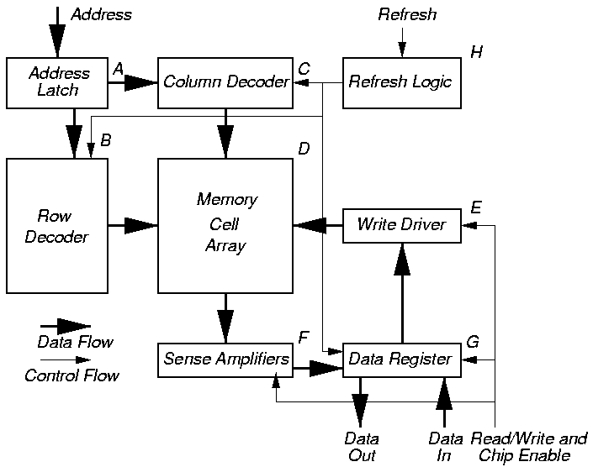
Functional Model

Slide 21
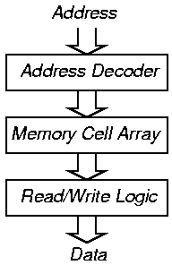
Simplified Functional Model

Slide 22
Reduced Functional Model (van de Goor)
n Memory bits, B bits/word, n/B addresses
Access happens when Address Latch contents change
Low-order address bits operate column decoder, high-order operate row decoder
read -- Precharge bit lines, then activate row
write -- Keep driving bit lines during evaluation
Refresh -- Read all bits in 1 row and simultaneously refresh them

Slide 23
Subset Functional Faults
Functional fault
Cell stuck
Driver stuck
Read/write line stuck
Chip-select line stuck
Data line stuck
Open circuit in data line
Short circuit between data lines
Crosstalk between data lines
a
b
c
d
e
f
g
h

Slide 24
Subset Functional Faults (Continued)
Functional fault
Address line stuck
Open circuit in address line
Shorts between address lines
Open circuit in decoder
Wrong address access
Multiple simultaneous address access
Cell can be set to 0 but not to 1 (or vice versa)
Pattern sensitive cell interaction
i
j
k
l
m
n
o
p

Slide 25
Reduced Functional Faults
Fault
Stuck-at fault
Transition fault
Coupling fault
Neighborhood Pattern Sensitive fault
SAF
TF
CF
NPSF

Slide 26
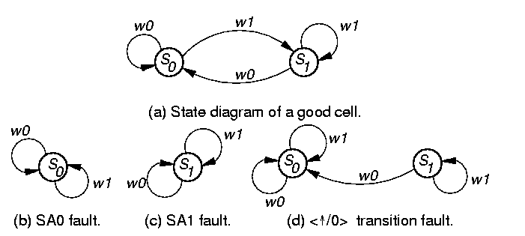
Stuck-at Faults
Condition: For each cell, must read a 0 and a 1.
< /0> (< /1>)
A
A

Slide 27
Transition Faults
Cell fails to make 0 1 or 1 0 transition
Condition: Each cell must undergo a transition and a transition, and be read after such, before undergoing any further transitions.
< /0>, < /1>
< /0> transition fault

Slide 28
Coupling Faults
Coupling Fault (CF): Transition in bit j causes unwanted change in bit i
2-Coupling Fault: Involves 2 cells, special case of k-Coupling Fault
  Must restrict k cells to make practical
Inversion and Idempotent CFs -- special cases of 2-Coupling Faults
Bridging and State Coupling Faults involve any # of cells, caused by logic level
Dynamic Coupling Fault (CFdyn) -- Read or write on j forces i to 0 or 1

Slide 29
Inversion Coupling Faults (CFin)
or in cell j inverts contents of cell i
Condition: For all cells that are coupled, each should be read after a series of possible CFins may have occurred, and the # of coupled cell transitions must be odd (to prevent the CFins from masking each other).
< ; > and < ; >

Slide 30
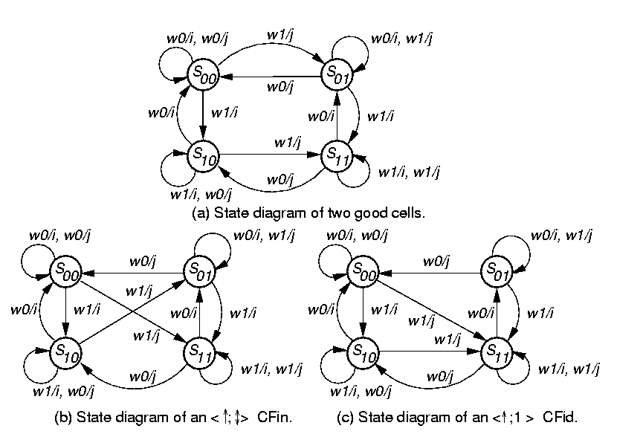
Good Machine State Transition Diagram

Slide 31
CFin State Transition Diagram

Slide 32
Idempotent Coupling Faults (CFid)
or transition in j sets cell i to 0 or 1
Condition: For all coupled faults, each should be read after a series of possible CFids may have happened, such that the sensitized CFids do not mask each other.
Asymmetric: coupled cell only does or
Symmetric: coupled cell does both due to fault
< ; 0>, < ; 1>, < ; 0>, < ; 1>

Slide 33
CFid Example

Slide 34
Dynamic Coupling Faults (CFdyn)
Read or write in cell of 1 word forces cell in different word to 0 or 1
<r0 | w0 ; 0>, <r0 | w0 ; 1>, < r1 | w1 ; 0>, and <r1 | w1; 1>
  | Denotes “OR” of two operations
More general than CFid, because a CFdyn can be sensitized by any read or write operation

Slide 35
Bridging Faults
Short circuit between 2+ cells or lines
0 or 1 state of coupling cell, rather than coupling cell transition, causes coupled cell change
Bidirectional fault -- i affects j, j affects i
AND Bridging Faults (ABF):
  < 0,0 / 0,0 >, <0,1 / 0,0 >, <1,0 / 0,0>, <1,1 / 1,1>
OR Bridging Faults (OBF):
  < 0,0 / 0,0 >, <0,1 / 1,1 >, <1,0 / 1,1>, <1,1 / 1,1>

Slide 36
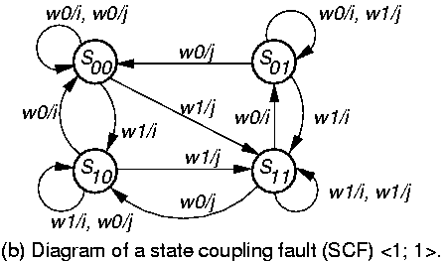
State Coupling Faults
Coupling cell / line j is in a given state y that forces coupled cell / line i into state x
< 0;0 >, < 0;1 >, < 1;0 >, < 1;1 >

Slide 37
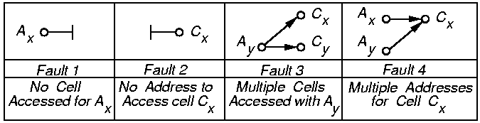
Address Decoder Faults (ADFs)
Address decoding error assumptions:
  Decoder does not become sequential
  Same behavior during both read & write
Multiple ADFs must be tested for
Decoders have CMOS stuck-open faults

Slide 38
Theorem 9.2
A March test satisfying conditions 1 & 2 detects all address decoder faults.
... Means any # of read or write operations
Before condition 1, must have wx element
  x can be 0 or 1, but must be consistent in test
Condition
1
2
March element
(rx, …, w x )
(r x , …, wx)

Slide 39
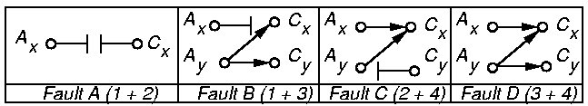
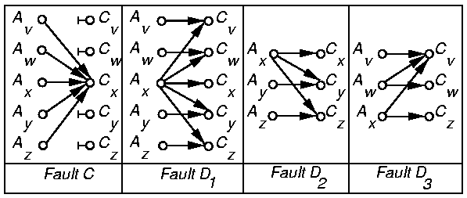
Proof Illustration

Slide 40
Necessity Proof
Removing rx from Condition 1 prevents A or B fault detection when x read
Removing rx from Condition 2 prevents A or B fault detection when x read
Removing rx or wx from Condition 1 misses fault D2
Removing rx or wx from condition 2 misses fault D3
Removing both writes misses faults C and D1

Slide 41
Sufficiency Proof
Faults A and B: Detected by SAF test
Fault C: Initialize memory to h (x or x). Subsequent March element that reads h and writes h detects Fault C.
  Marching writes h to A_{v}. Detection: read A_{w}
  Marching writes h to A_{z}. Detection: read A_{y}
Fault D: Memory returns random result when multiple cells read simultaneously. Generate fault by writing A_{x}, Detection: read A_{w} or A_{y} ( or marches)

Slide 42
Reduced Functional Faults
Fault
SAF
SAF
SAF
SAF
SAF
SAF
CF
CF
AF
AF
AF
AF
AF
AF
TF
NPSF
Functional fault
Cell stuck
Driver stuck
Read/write line stuck
Chip-select line stuck
Data line stuck
Open circuit in data line
Short circuit between data lines
Crosstalk between data lines
Address line stuck
Open circuit in address line
Shorts between address lines
Open circuit in decoder
Wrong address access
Multiple simultaneous address access
Cell can be set to 0 (1) but not to 1 (0)
Pattern sensitive cell interaction
a
b
c
d
e
f
g
h
i
j
k
l
m
n
o
p

Slide 43
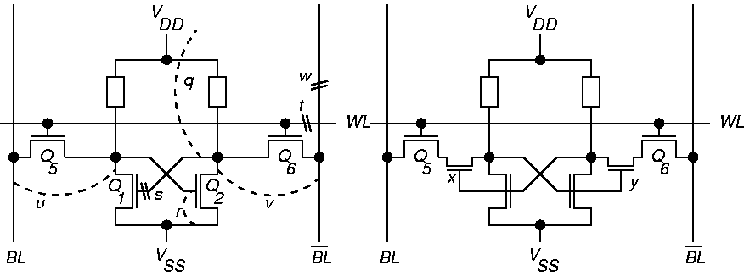
Fault Modeling Example 1
SA0
SAF
AF+SAF
SCF<0;0>
SA0
SCF<1;1>
SA0
TF< /1>
TF< /0>

Slide 44
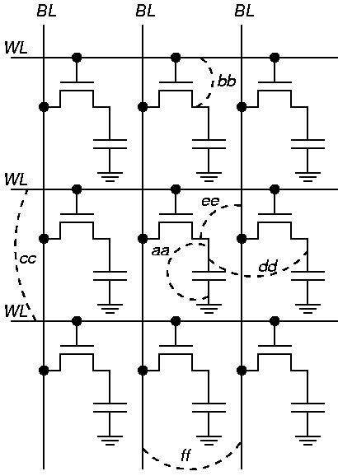
Fault Modeling Example 2
SA1
gg
SA1+SCF
ABF
ABF
SCF
SA0
ABF

Slide 45
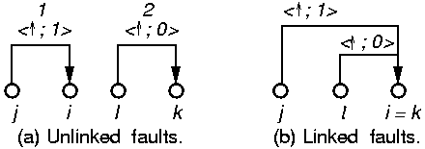
Multiple Fault Models
Coupling Faults: In real manufacturing, any # can occur simultaneously
Linkage: A fault influences behavior of another
Example March test that fails:
  { (w0) ; (r0, w1); (w0, w1); (r1)}
  Works only when faults not linked

Slide 46
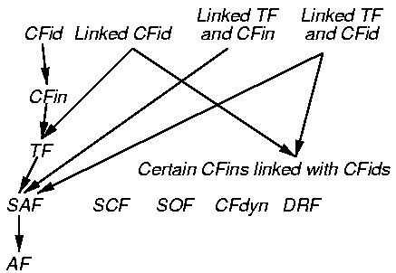
Fault Hierarchy

Slide 47
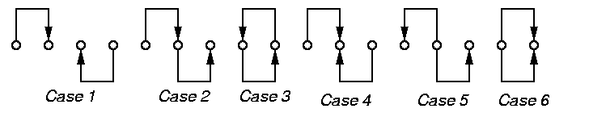
Tests for Linked AFs
Cases 1, 2, 3 & 5 -- Unlinked
Cases 4 & 6 -- Linked

Slide 48
DRAM/SRAM Fault Modeling
DRAM or SRAM Faults
Shorts & opens in memory cell array
Shorts & opens in address decoder
Access time failures in address decoder
Coupling capacitances between cells
Bit line shorted to word line
Transistor gate shorted to channel
Transistor stuck-open fault
Pattern sensitive fault
Diode-connected transistor 2 cell short
Open transistor drain
Gate oxide short
Bridging fault
Model
SAF,SCF
AF
Functional
CF
IDDQ
IDDQ
SOF
PSF

Slide 49
SRAM Only Fault Modeling
Faults found only in SRAM
Open-circuited pull-up device
Excessive bit line coupling capacitance
Model
DRF
CF

Slide 50
DRAM Only Fault Modeling
Faults only in DRAM
Data retention fault (sleeping sickness)
Refresh line stuck-at fault
Bit-line voltage imbalance fault
Coupling between word and bit line
Single-ended bit-line voltage shift
Precharge and decoder clock overlap
Model
DRF
SAF
PSF
CF
PSF
AF

Slide 51
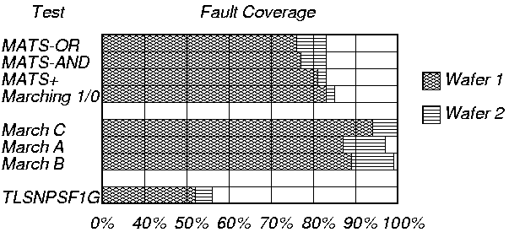
Test Influence on SRAM Fault Coverage

Slide 52
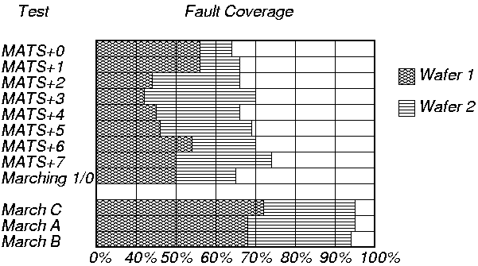
Influence of Addressing Order on Fault Coverage

Slide 53
Critical Path Length
Length of parallel wires separated by dimension of spot defect size
TFs and CFids happen only on long wires
Fault class
Stuck-at
Stuck-open
Transition
State Coup.
Idemp. Coup.
Data retention
Total
Spot defect size (μm)
<2
78
32
0
15
0
27
152
<3
213
64
36
15
0
29
357
<5
227
64
38
51
0
80
460
<7
269
64
38
71
0
80
522
<9
269
64
38
71
18
80
540
<2
51.3%
21.0%
0%
9.9%
0%
17.8%
100%
<9
49.8%
11.9%
7.0%
13.2%
3.3%
14.8%
100%

Slide 54
Fault Frequency
Obtained with Scanning Electron Microscope
CFin and TF faults rarely occurred
Cluster
0
1
2
3
4
5
7
--
14
# Devices
714
169
18
9
8
5
26
--
2
Fault class
Stuck-at and Total failure
Stuck-open
Idempotent coupling
State coupling
?
?
Data retention
?
?

Slide 55
Functional RAM Testing with March Tests
March Tests can detect AFs -- NPSF Tests Cannot
Conditions for AF detection:
  Need ( r x, w x)
  Need ( r x, w x)
In the following March tests, addressing orders can be interchanged

Slide 56
Irredundant March Tests
Algorithm
MATS
MATS+
MATS++
MARCH X
MARCH
C—
MARCH A
MARCH Y
MARCH B
Description
{ (w0); (r0, w1); (r1) }
{ (w0); (r0, w1); (r1, w0) }
{ (w0); (r0, w1); (r1, w0, r0) }
{ (w0); (r0, w1); (r1, w0); (r0) }
{ (w0); (r0, w1); (r1, w0);
(r0, w1); (r1, w0); (r0) }
{ (w0); (r0, w1, w0, w1); (r1, w0, w1);
(r1, w0, w1, w0); (r0, w1, w0) }
{ (w0); (r0, w1, r1); (r1, w0, r0); (r0) }
{ (w0); (r0, w1, r1, w0, r0, w1);
(r1, w0, w1); (r1, w0, w1, w0);
(r0, w1, w0) }

Slide 57
Irredundant March Test Summary
Algorithm
MATS
MATS+
MATS++
MARCH X
MARCH C—
MARCH A
MARCH Y
MARCH B
SAF
All
All
All
All
All
All
All
All
AF
Some
All
All
All
All
All
All
All
TF
All
All
All
All
All
All
CF
in
All
All
All
All
All
CF
id
All
CF
dyn
All
SCF
All
Linked
Faults
Some
Some
Some

Slide 58
March Test Complexity
Algorithm
MATS
MATS+
MATS++
MARCH X
MARCH C—
MARCH A
MARCH Y
MARCH B
Complexity
4n
5n
6n
6n
10n
15n
8n
17n

Slide 59
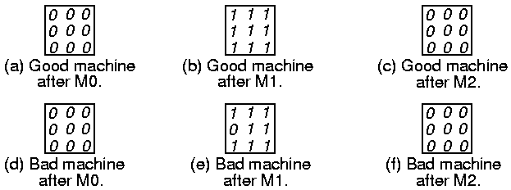
MATS+ Example
Cell (2,1) SA0 Fault
MATS+:
{ M0: (w0); M1: (r0, w1); M2: (r1, w0) }

Slide 60
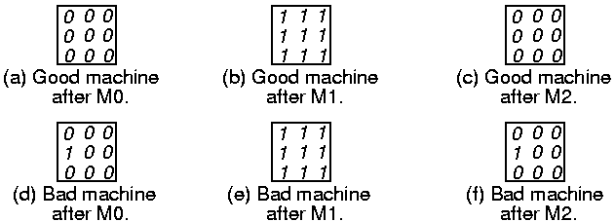
MATS+ Example
Cell (2, 1) SA1 Fault
MATS+:
{ M0: (w0); M1: (r0, w1); M2: (r1, w0) }

Slide 61
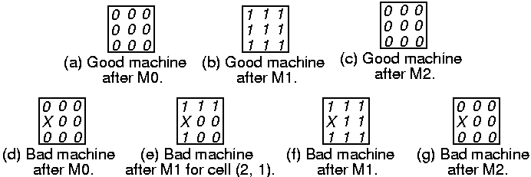
MATS+ Example
Multiple AF Type C
Cell (2,1) is not addressable
Address (2,1) maps into (3,1) & vice versa
Can’t write (2,1), read (2,1) gives random #
MATS+:
{ M0: (w0); M1: (r0, w1); M2: (r1), w0 }

Slide 62
RAM Tests for Layout-Related Faults
Inductive Fault Analysis:
Generate defect sizes, location, layers based on fabrication line model
Place defects on layout model
Extract defective cell schematic & electrical parameters
Evaluate cell testing, using VLASIC
Dekker found these faults:
  SAF, SOF, TF, SCF, CFid, DRF
  Proposed IFA-9 March test
  Delay means wait 100 ms

Slide 63
Inductive Fault Analysis March Tests
Algor-
ithm
IFA-9
IFA-13
Physical Defect Fault Coverage
SAF
All
All
TF
All
All
AF
All
All
SOF
All
SCF
All
All
CFid
All
All
DRF
All
All
Operations
12n+Delays
16n+Delays
Algor-
ithm
IFA-9
IFA-13
Description
{ (w0); (r0, w1); (r1, w0); (r0, w1);
(r1, w0); Delay; (r0, w1); Delay; (r1) }
{ (w0); (r0, w1, r1); (r1, w0, r0);
(r0, w1, r1), (r1, w0, r0),
Delay; (r0, w1); Delay; (r1) }

Slide 64
IFA Test Validation
Higher scores show better tests
Test
MATS+
MATS+ and Delay
March C
March C and Delay
IFA-9 and Delay
IFA-13
IFA-13 and Delay
Score
7
18
61
89
91
80
92
Test Time
5n
8n + 2 Delay
11n
14n + 2 Delay
12n + 2 Delay
13n
16n + 2 Delay

Slide 65
Memory Testing Summary
Multiple fault models are essential
Combination of tests is essential:
  March – SRAM and DRAM
  NPSF -- DRAM
  DC Parametric -- Both
  AC Parametric -- Both
Inductive Fault Analysis is now required

